Slide 1
Introduction to Object Oriented
Session 13
(Lecture)
Course : Program Design Methods
Effective Period : July 2018

Slide 2
These slides have been adapted from
Britton, C.. (2005). A student Guide to Object Oriented Development. 01. Butterworth-Heinemann. Amsterdam. ISBN: 978-0-7506-6123-2. Chapter 3 - 4
Acknowledgement

Slide 3
LO 5 : Explain the object oriented design
Learning Objectives

Slide 4
Contents
Abstraction
Class & Object
Encapsulation
Polymorphism
Instance
Use Case Diagram
Use Case Description
Actors and Actor Description
Use Case Relationship
Boundary

Slide 5
Advantages of
OO Development
Advantages of Object Oriented Development
  Autonomous, i.e did not depend heavily on other modules
  Cohesive with a single, well – defined purpose
  Easy to understand
  Easily adapted to accommodate new or changed requirement
  Based on data
  Encapsulated data
  A well – define public interface

Slide 6
Object
An object is a representation of something in the application area about which we need to store data to enable the system to do what the users want it to
An object can be defined as a container for both a set of characteristics and a set of operations that can be performed on its data.
An object is a concept, abstraction, or thing with clear boundaries and meaning in the current application area.

Slide 7
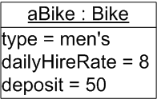
Object
Every object in a system has three characteristics : behaviour , state and identity
Object name
Class name
Attributes

Slide 8
Characteristics of an Object
Behaviour
  Processes that act on related data item that manipulate the data are called operations
  An object’s behaviour is divided into operations, each of which represents something the object can do
  An object’s behaviour is triggered in response to a message sent from another object asking it to perform one it its operations

Slide 9
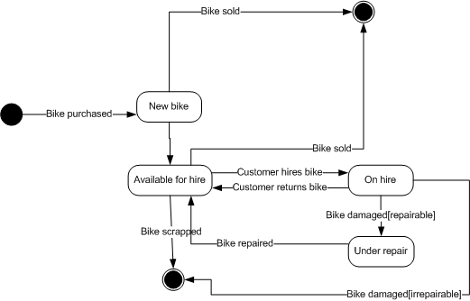
Characteristics of an Object
State
  The state of an object is determined by the values of its attributes and its links to other objects

Slide 10
Characteristics of an Object
Identity
  Each object is unique, it has a separate existence and ultimately a separate space in the computer memory for every other object
  Property of an object that distinguishes it for all other object [Booch, 1994]

Slide 11
Encapsulation and
Information Hiding
Data can be hidden inside an object in such a way that it is protected and cannot be directly accessed by other parts of the program
Information hiding is achieved through encapsulation
Encapsulation is the process of encapsulating the elements of an abstraction that constitutes its structure and behaviour; encapsulation serves to separate the contractual interface of an abstraction and its implementation [Booch, 1994]
Encapsulation is the principle of designing a software system in such a manner that the interface to a program component (object) reveals as little as possible about the inner workings of that objects

Slide 12
Class
A class of objects is a group of objects with the same set of attributes, the same relationships and the same behaviour [Britton, 2005]
A class is a group of objects that share common properties [Robertson, 2006]
A group of objects with similar properties (attributes), common behaviour (operation), common relationships to other objects, and common semantics [Rumbaugh,1991]
Objects are sometimes called instances of classes; the process of creating a new object belonging to a class is called instantiation

Slide 13
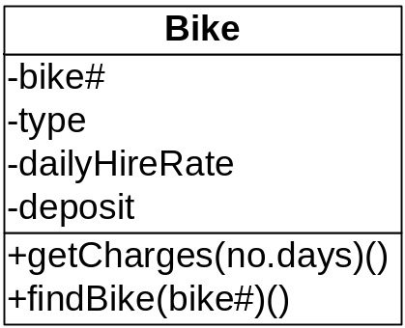
Class
For example : a Bike object knows that it can display its number and work out of the cost of hiring it (or rather the bike it represents) for a given number of days . However, the code for these operations is part of the Bike class
Figure : The Bike class form the Wheels system

Slide 14
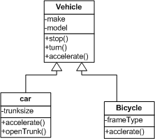
Polymorphism
Polymorphism, meaning many shaped, refers to the use of the same method name in different classes to perform a variety of purposes.
Polymorphism is a concept that permit different objects to respond differently to the same message

Slide 15
Polymorphism
Polymorphism
  Describes the use of operations of the same name for variety of purposes
  Operating overrides occurs when a parent class provides an operation, but the inheriting child class defines its own version of that operation
  In another type of polymorphism, overloading, several operations in a single class can have the same name

Slide 16
Polymorphism
Operation overriding
  Occurs when a parent class provides an operation but the inheriting child class defines its own version of that operation
  The operation in a subclass will override the operation in the superclass

Slide 17
Polymorphism
Operation overloading
  Occurs when several operations in a single class have the same name but will act differently according to the number of parameters that are passed to the operation when it is called

Slide 18
Use Case Diagram
Use case model the user’s view of functionality of a system
The use case model provide a means of organizing, structuring, and documenting the mass of information during requirement elicitation
The use case model consist of a use case diagram, a set of use case description and a set of scenarios
The use case diagram models the problem domain graphically using four concepts : the use case, the actor, the relationship link and the boundary.

Slide 19
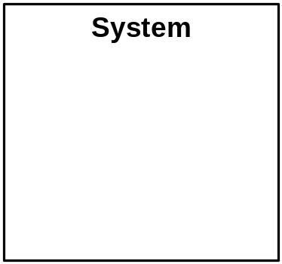
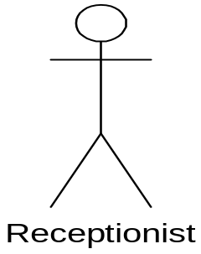
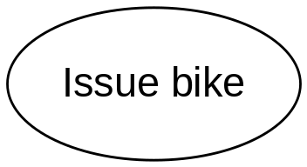
Use Case Diagram
A Use case : an
ellipse labeled
with the name
of the use case
An actor : a stick
figure labeled
with the name of
the actor. The
stick figure icon is
used even when
the actor is non
human, e.g an
organization
A use case
relationship : a
line linking an
actor to a use
case. This
relationship is
also known as a
Communication
association
The boundary : a
line drawn round
the use cases to
separate them
from the actors
and to delineate
the area of
interest

Slide 20
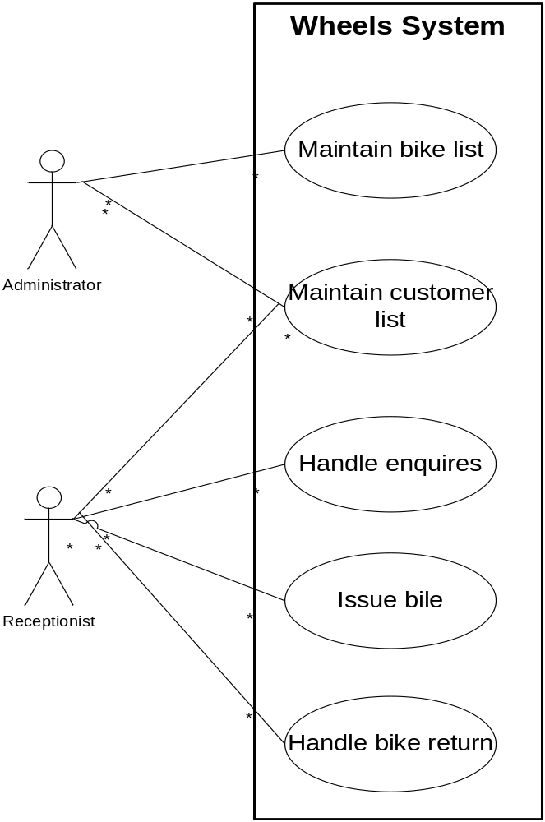
Example
The functionality of the new system has been divided into five use cases :’Maintain bike list’, ‘Maintain customer list’, ‘Handle enquires’, ‘Issue bike’, and ‘Handle bike return’
The actor, represented by a stick figure, is the person who uses the system in the way specified in the use case

Slide 21
The Use Case
There are two ways of identifying the use case
  Identifying use cases from the actors
    Identify the actors, the users of the system, and for each one, to establish how they use the system, what they use it to achieve
  Identifying use cases from scenarios
    Scenarios describes a series of interactions between the user and the system in order to achieve a specified goal. A scenario describe a specific sequence of events.

Slide 22
Use Case Descriptions
The use case description is a narrative document that describes, in general terms, the required functionality of the use case. Typically it describes the use case goal and gives a general description of what usually happens, the normal course of events, adding a brief description of any minor variations
The use case descriptions can be categorized into two
  High level description : these description need only document the purpose of the use case , the actor involved and give general overview of what happens
  Expanded use case : this description is more detailed and structured that the high level use case description. It should document : what happens to initiate the use case, which actors are involved, which data has to be input, the use case output, what stored data is needed by the use case, what happens to signal the completion of the use case, minor variation in the sequences events

Slide 23
Actors and Actor description
Actor :
  Is someone who inputs information to the system or receive information from it
  An actor represents a particular way of using the system; a way of interacting with the system to achieve a use case goal
Actors are identified by asking such question as :
  Who is involved in major system processes such as issuing bikes ?
  Who will use the new system?
  Who supplies information to the system ?
  Who will receive output from the system ?

Slide 24
Use Case relationship
Type of use case relationship
  Communication association :
    Represent by the line linking an actor to a use case
    Shows with actors are associated with which use case
    Each actor may be associated with many use cases and each use case may be associated with many actors
  Include
    Is useful where there is a chunk of behaviour that is common to several use cases
    Rather than repeat a description of that behaviour in several use case description, the common behaviour can be split off into a separate use case which is then linked to all relavant use cases with an <<include>> relationship
  Extend
    Is used as way of specifying significant alternative behaviour in a use case
    It usually documents functionality that the user can opt to use over and about the norm

Slide 25
Boundary
Boundary
  It is shown as a line round the use cases, separating them from the actors, normally it is labaled with the name of the system or subsystem.

Slide 26
References
Britton, C.. (2005). A student Guide to Object Oriented Development. 01. Butterworth-Heinemann. Amsterdam. ISBN: 978-0-7506-6123-2.
Data encapsulation, http://java.about.com/od/objectorientedprogramming/a/encapsulation.htm
Object Oriented Concept, http://www.apl.jhu.edu/Classes/Notes/Demasco/605704/ObjectOrientedConcepts.pdf
What is class ?, http://java.sun.com/docs/books/tutorial/java/concepts/class.html
Introduction to Object Oriented, http://java.about.com/od/objectorientedprogramming/a/introobjects.htm

Slide 27
References
UML, http://www.apl.jhu.edu/Classes/Notes/Demasco/605704/UMLIntroduction.pdf
Use Case Diagram, http://www.objectmentor.com/resources/articles/usecases.pdf

Slide 28
Q & A

